Slide 1
Embeddings I: Metric Learning
CSCI 4360/6360 Data Science II

Slide 2
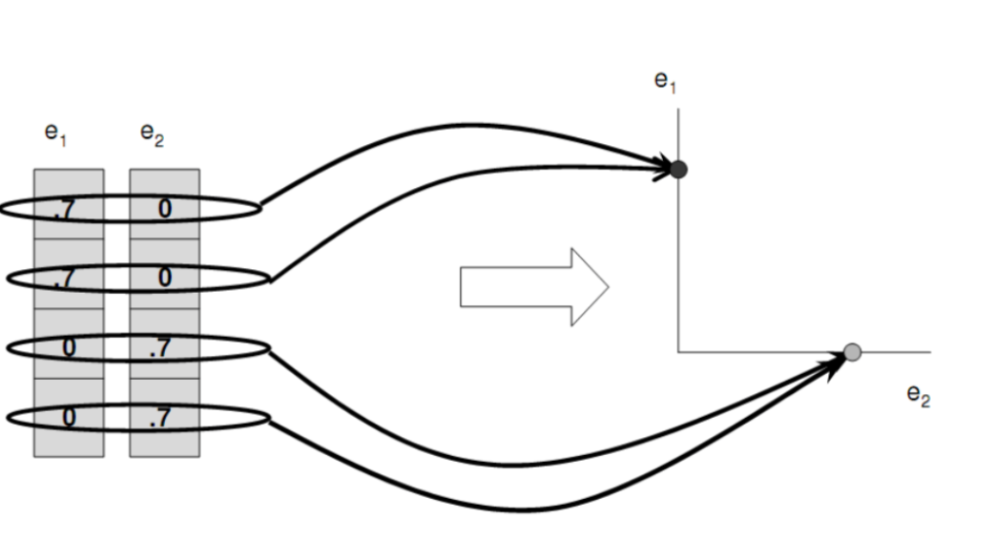
Previously…
Spectral clustering
Define graph (affinities -> Laplacian)
Compute eigenvectors (embedding)
Cluster embeddings trivially (K-means)

Slide 3

Embeddings
What is an embedding?
Mapping
Transformation
Reveals / preserves “structure”
Embedding

Slide 4
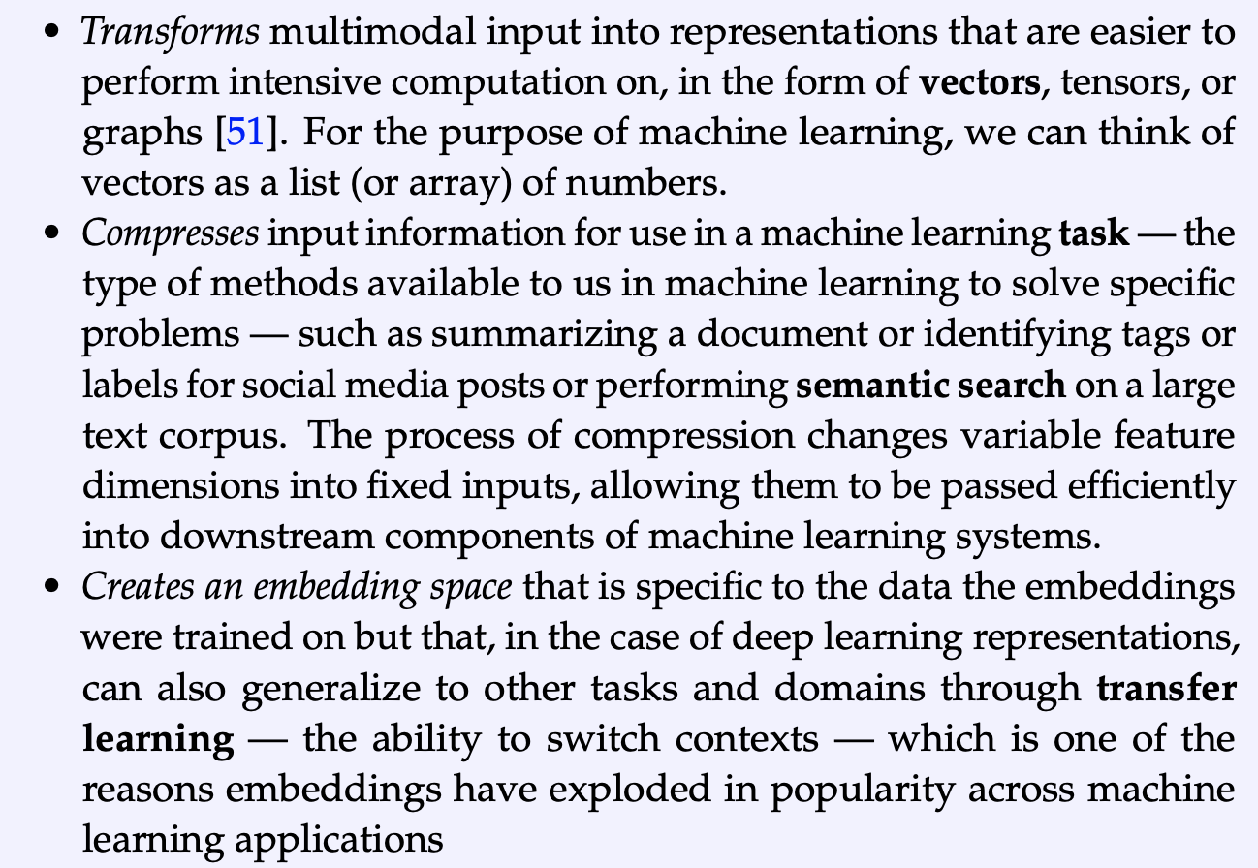
Embeddings
From Vicki Boykis’ “What Are Embeddings” (2023)
Transformation
Compression
Representation

Slide 5
Embedding Strategies (non-DL)
Linear
Principal Components Analysis (PCA)
Sparse & Kernel PCA (next Tuesday!)
Independent Components Analysis (ICA)
Non-negative Matrix Factorization (NMF)
Locally-linear Embeddings (LLE)
Dictionary Learning (next!)
Sparse & Nonlinear
Non-Gaussian
Non-negative
Nonlinear
Sparse & Nonlinear
Million Dollar Question:
How do you know the embedding is right?

Slide 6
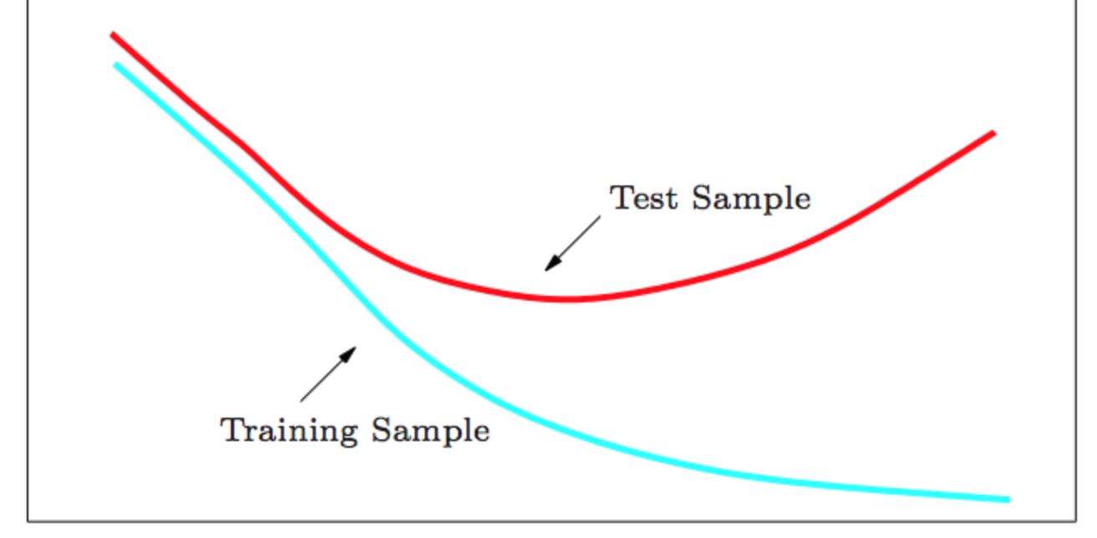
Embeddings
If you’re performing classification, it’s pretty easy to know if your embedding is “right”
Error decreases?
Error increases?
What about unsupervised learning?
?

Slide 7
Assumptions
Choice of embedding -> Assumptions about the data
What if we knew something about the data?
“Side information”: we don’t know what classes/clusters the data belong to, but we do have some notion of similarity

Slide 8
Side Information
Define a set S
for every pair x_{i} and x_{j} that are similar, we put this pair in S
”Similar” is user-defined; can mean anything
Likewise have a set D
for every pair x_{i} and x_{j} that are dissimilar, we put this pair in D
can consist of every pair not in S, or specific pairs if information is available
We have this similarity information; what can we do with it?

Slide 9





Distance Metrics
Goal: use side-information to learn a new distance metric
Encode our side-information in a “metric” A
Generalization of Euclidean distance
Note when A = I, this is regular Euclidean distance
When A is diagonal, this is a “weighted” Euclidean distance
When data are put through nonlinear basis functions $φ$, nonlinear metrics can be learned

Slide 10



Distance Metrics
Quick Review: What constitutes a valid distance metric?
1:
2:
3:
4:
Non-negativity
Symmetry
Triangle Inequality
Identity of indiscernibles
“Pseudometric”

Slide 11
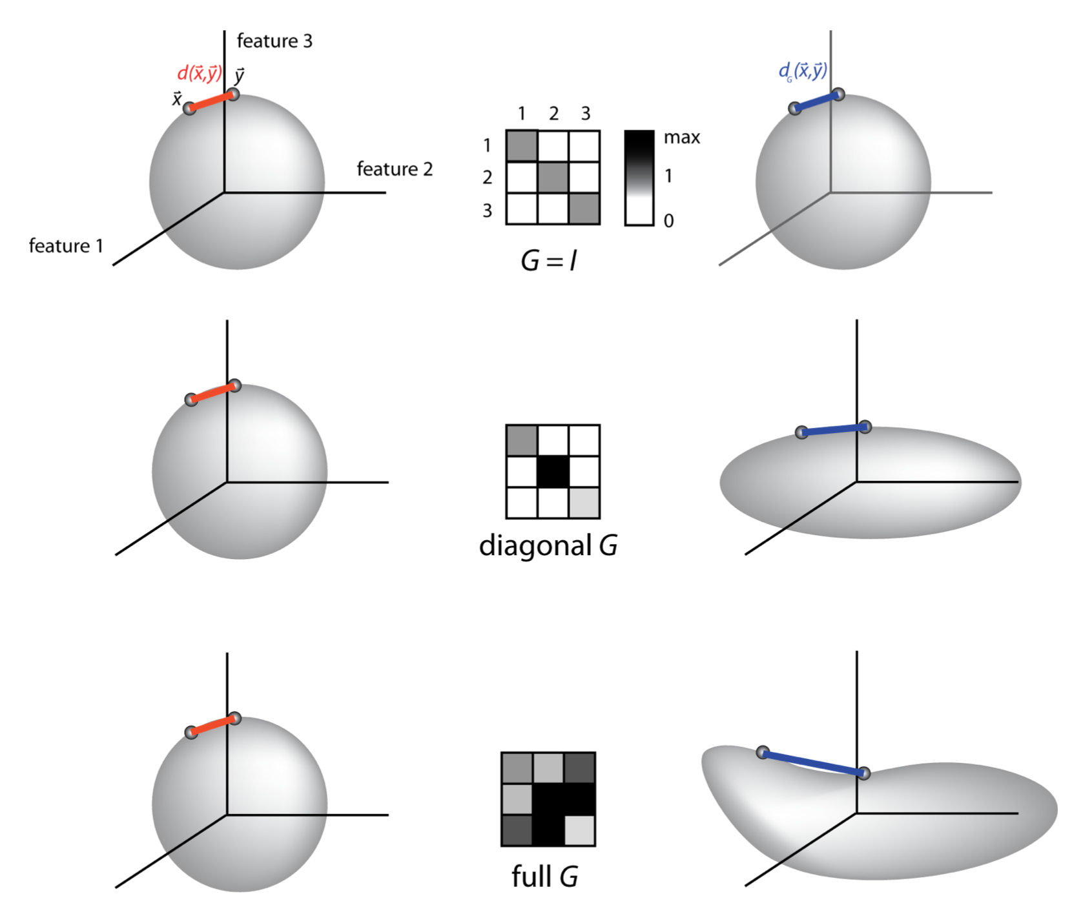
Form of a Metric
Learning metric A (G in figure) also equivalent to replacing each point x with A^{1/2}x and using standard Euclidean distance
It’s an embedding!
Learning a space inhabited by your data
Bonus: easy to incorporate new data! (unlike LLE or others)

Slide 12
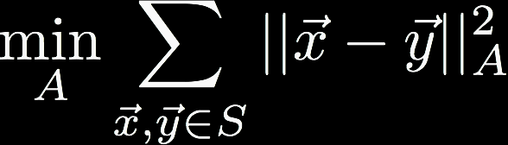
Learning a Metric (1)
Goal: Define a metric A that respects constraint sets S and D
Simple enough: constrain all pairs in S to have small distances
Is that all?
Nope – trivially solved with A = 0

Slide 13

Learning a Metric (2)
Additional constraint: use pairs in D to guarantee non-zero distances
(choice of 1 is arbitrary; any other constant c would have the effect of replacing A with c²A)
Is that all?
Nope – need to ensure A is positive semi-definite (why?)
Notes:
Because when A is PSD, its eigenvalues are real!!! (don’t say this—quiz on the next page)

Slide 14
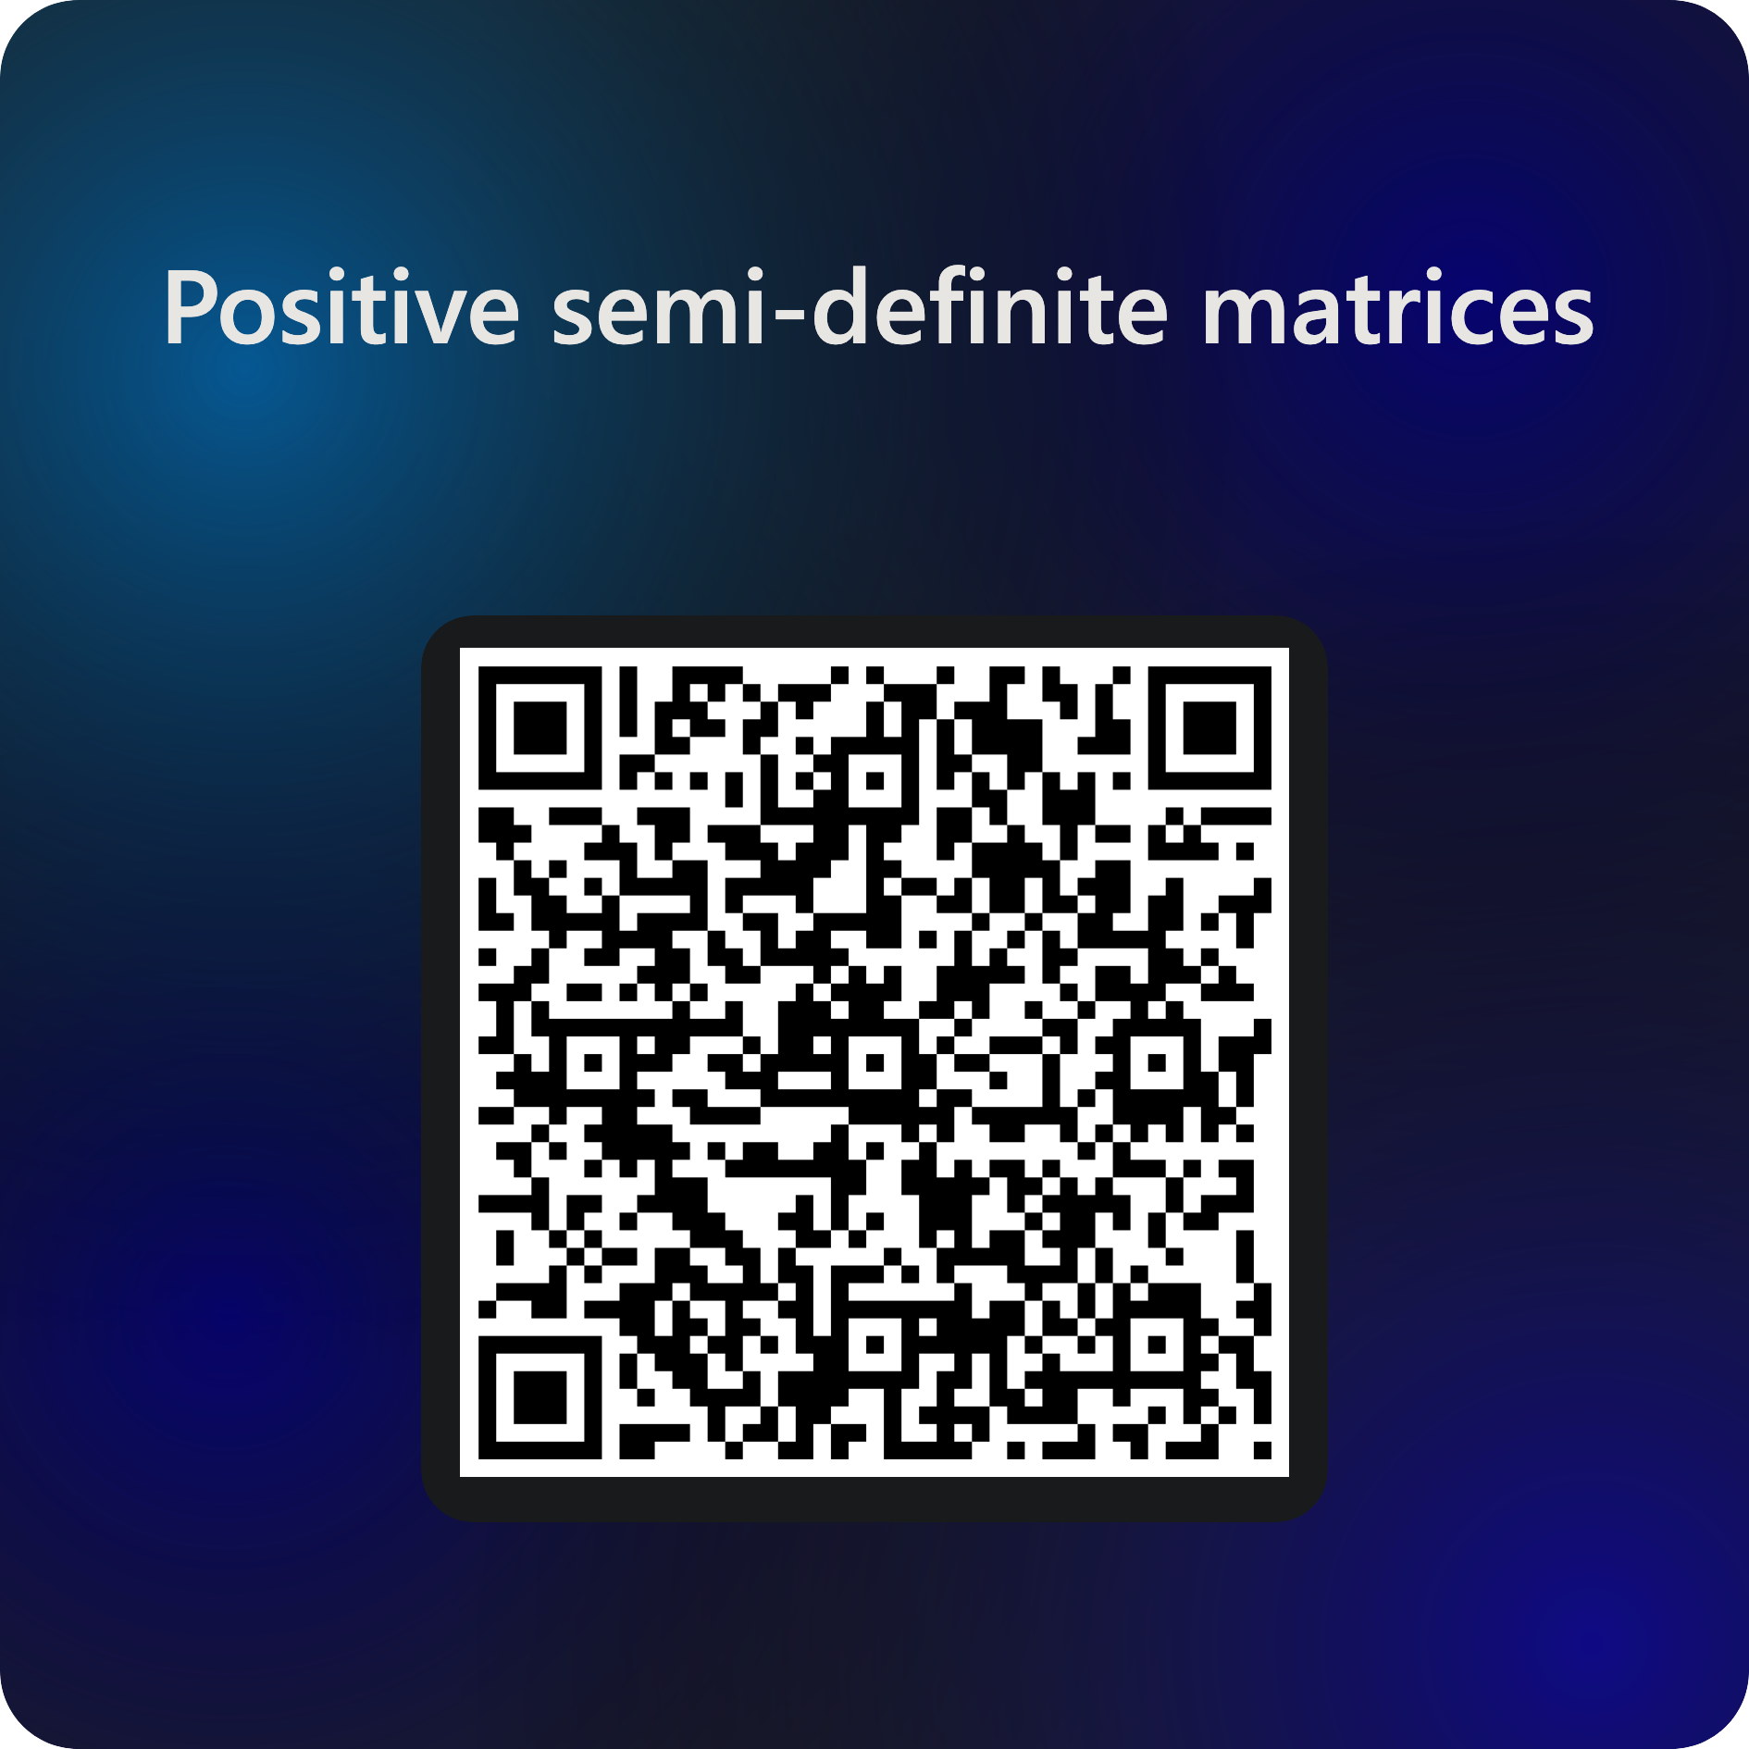


Slide 15
Aside!
We used squared Euclidean distance in the first constraint
But not in the second! Why?
Squared distance in 2nd constraint would always result in rank-1 A, i.e. the data would always be projected on a line
(proof left as an exercise!)

Slide 16



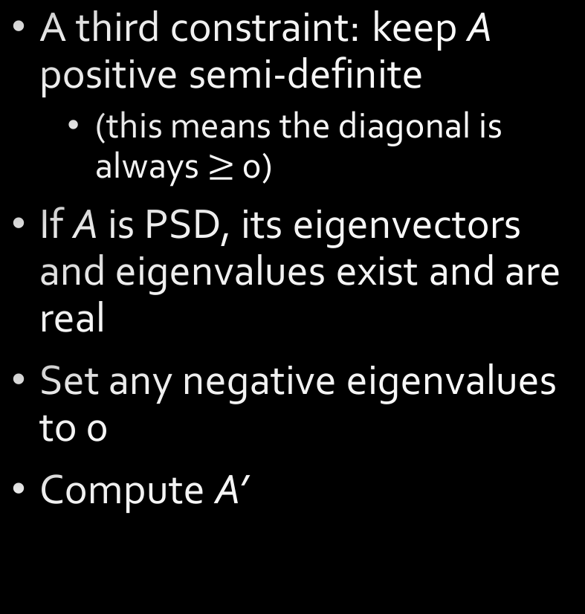
Learning a Metric (3)
A third constraint: keep A positive semi-definite
(this means the diagonal is always $≥$ 0)
If A is PSD, its eigenvectors and eigenvalues exist and are real
Set any negative eigenvalues to 0
Compute A’

Slide 17
Learning a Metric
We have our constraints!
How do we learn A?
(Hint) Linear in parameters of A
(HINT) First two constraints are verifiably convex

Slide 18
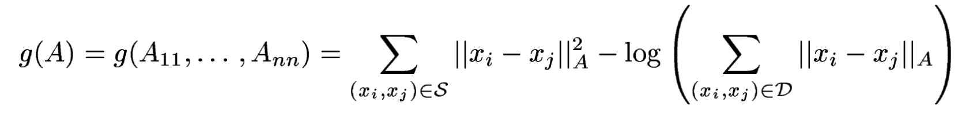
Convex Optimization
For diagonal A, this is easy
(just a fancy reformulation of the original constraints)
Minimizing g is equivalent to solving original problem, up to multiplication of A by a positive constant
Gradient descent! (step-size intrinsically enforces PSD of A)

Slide 19
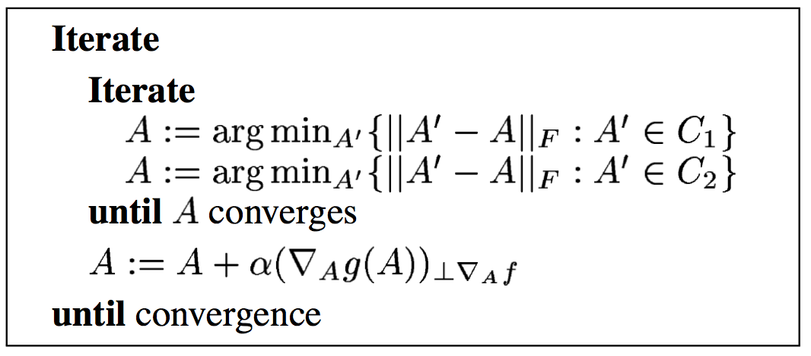
Convex Optimization
Trickier for full A
Gradient ascent + iterative projections
For this to work, constraints needed to be reversed

Slide 20


Constraint Reformulation
Previous
Current
C₁
g(A)
C₂

Slide 21
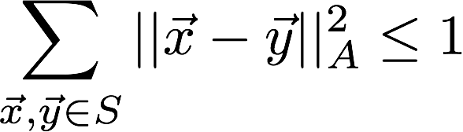
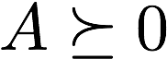

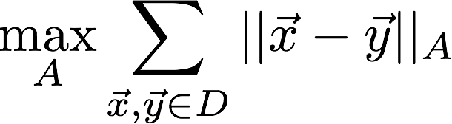
GA + IP

Slide 22
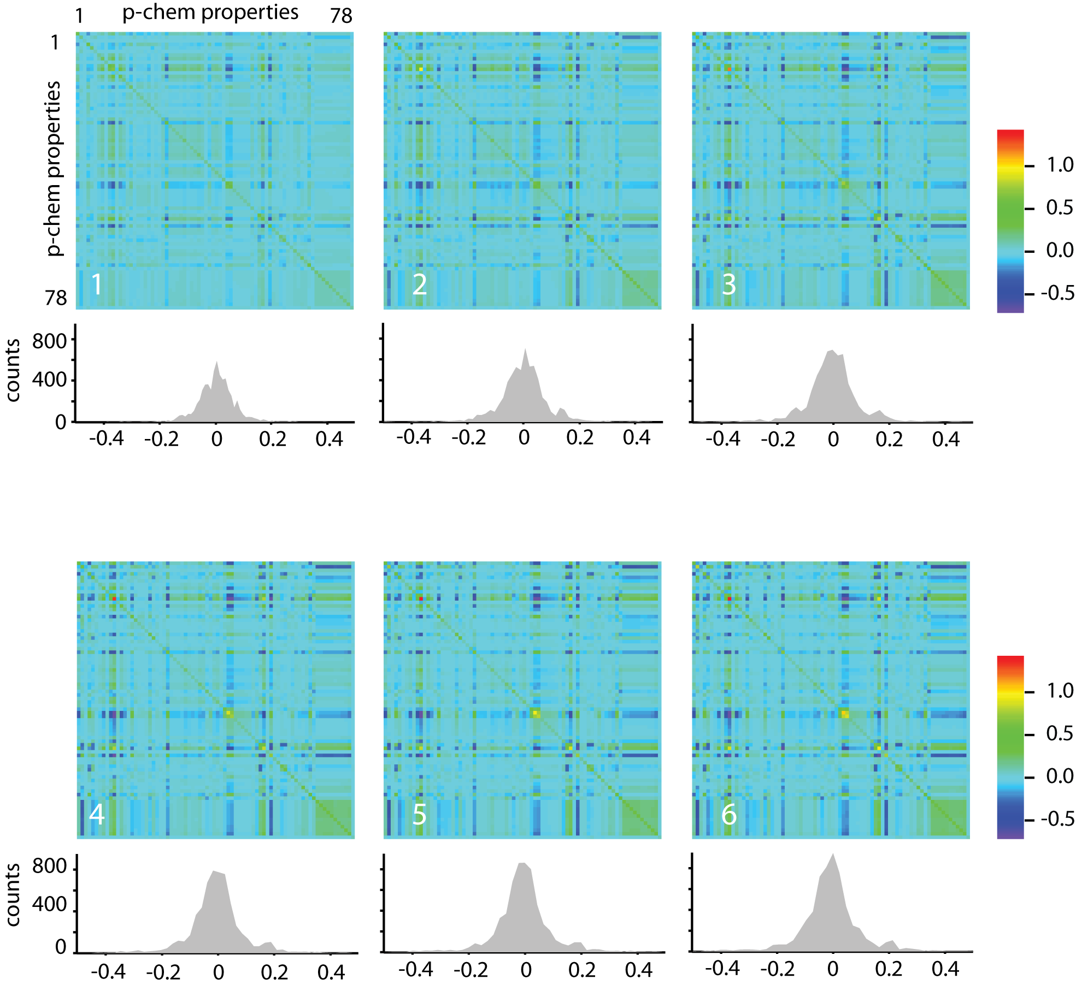
GA + IP

Slide 23
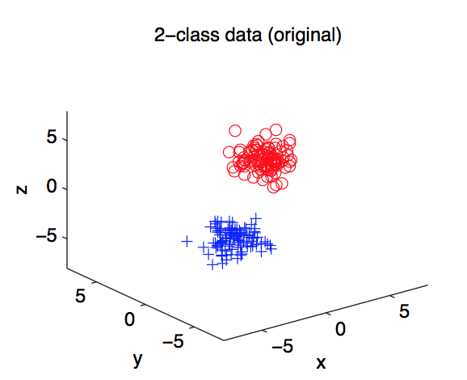
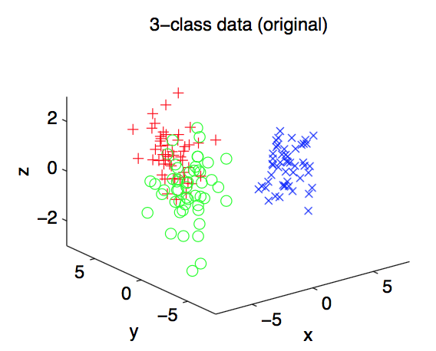
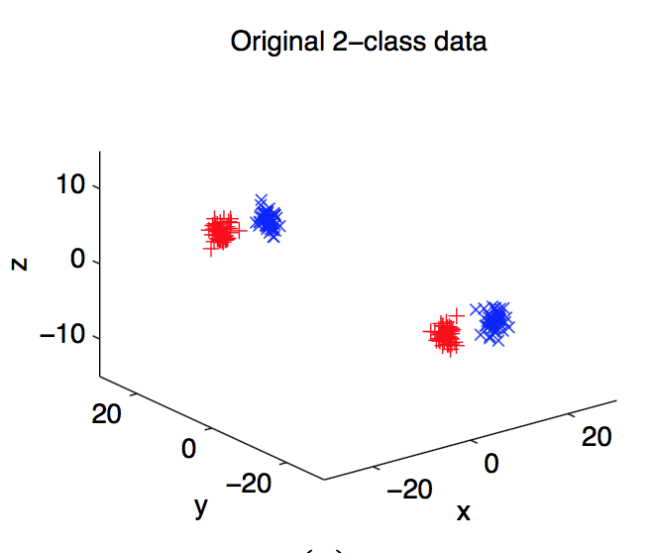
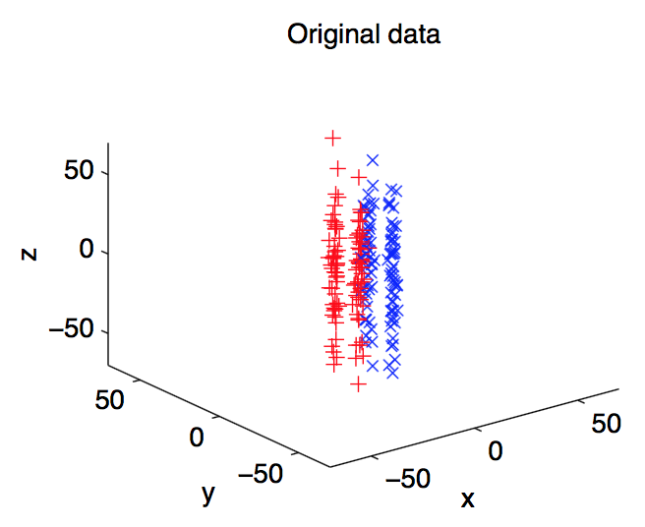
Experiments
Generated artificial 3D data
2 class
3 class
Separated by y-axis
Separated by z-axis

Slide 24
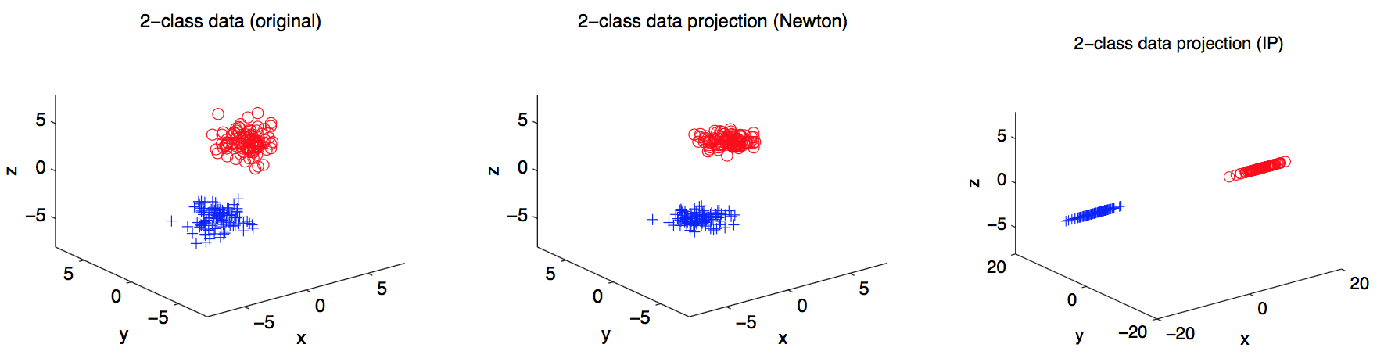
Experiments

Slide 25
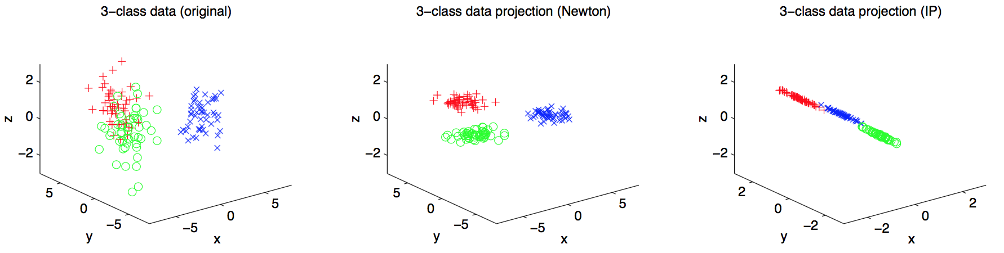
Experiments

Slide 26
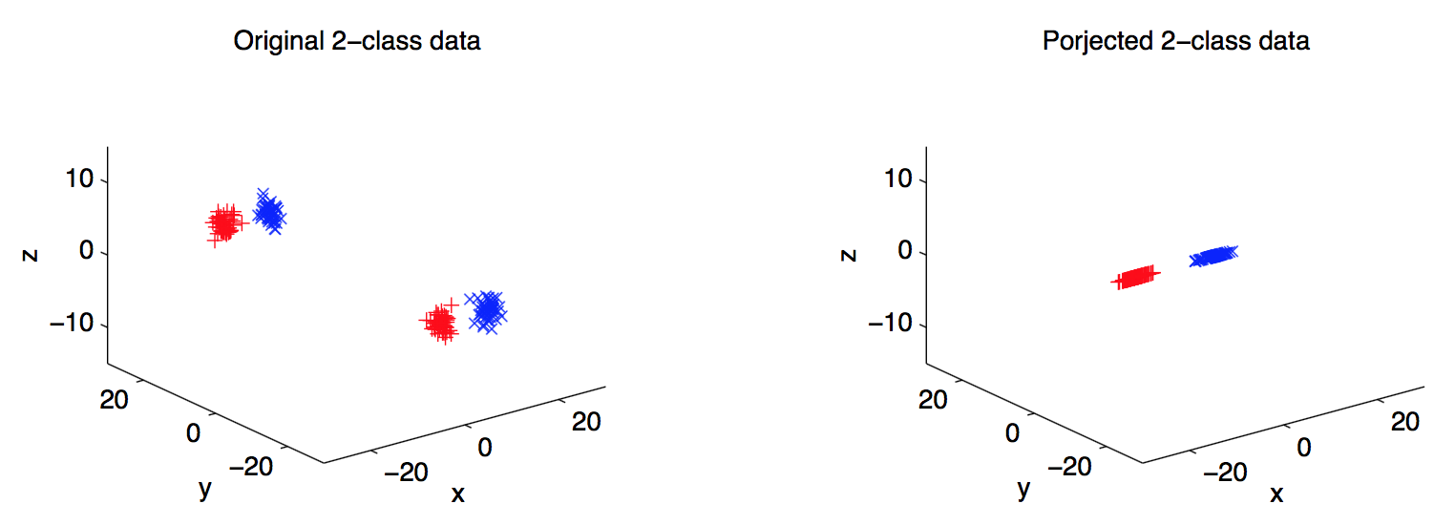
Experiments

Slide 27
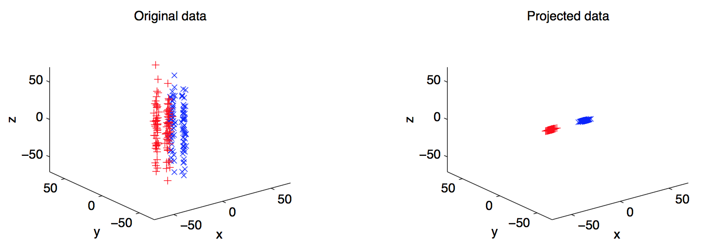
Experiments

Slide 28
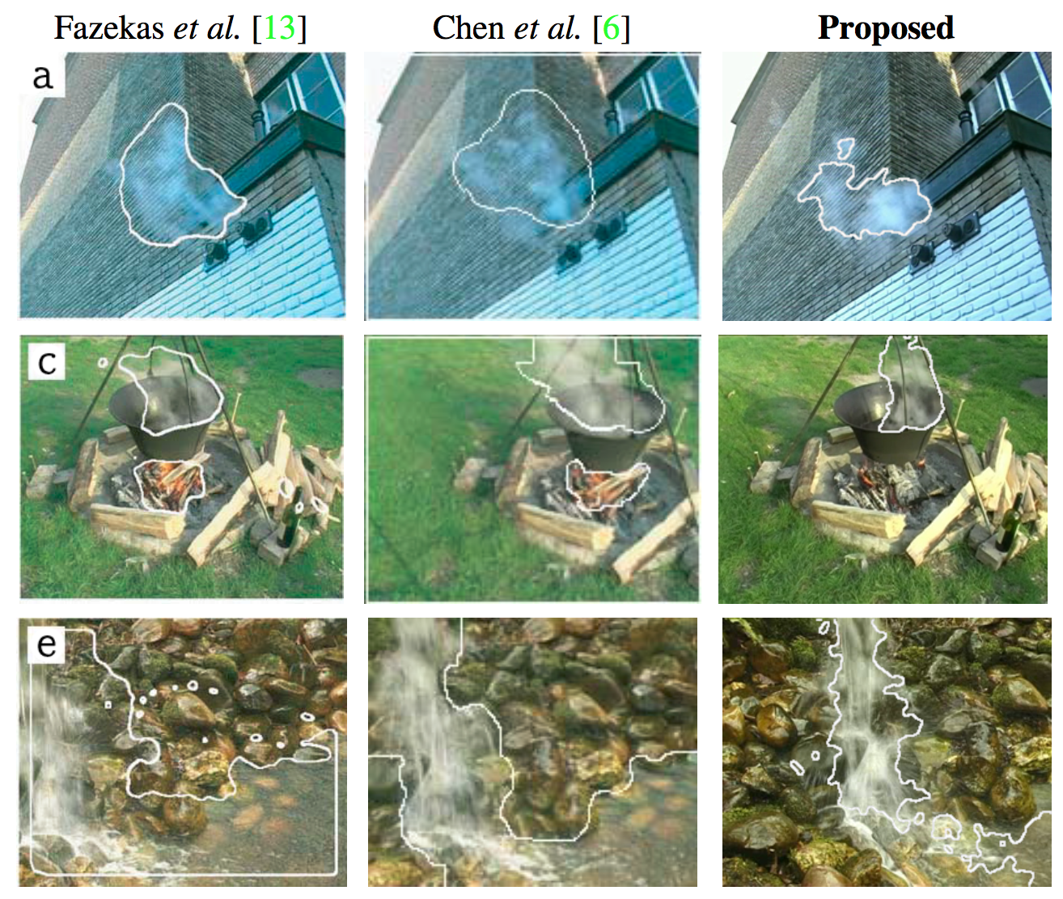
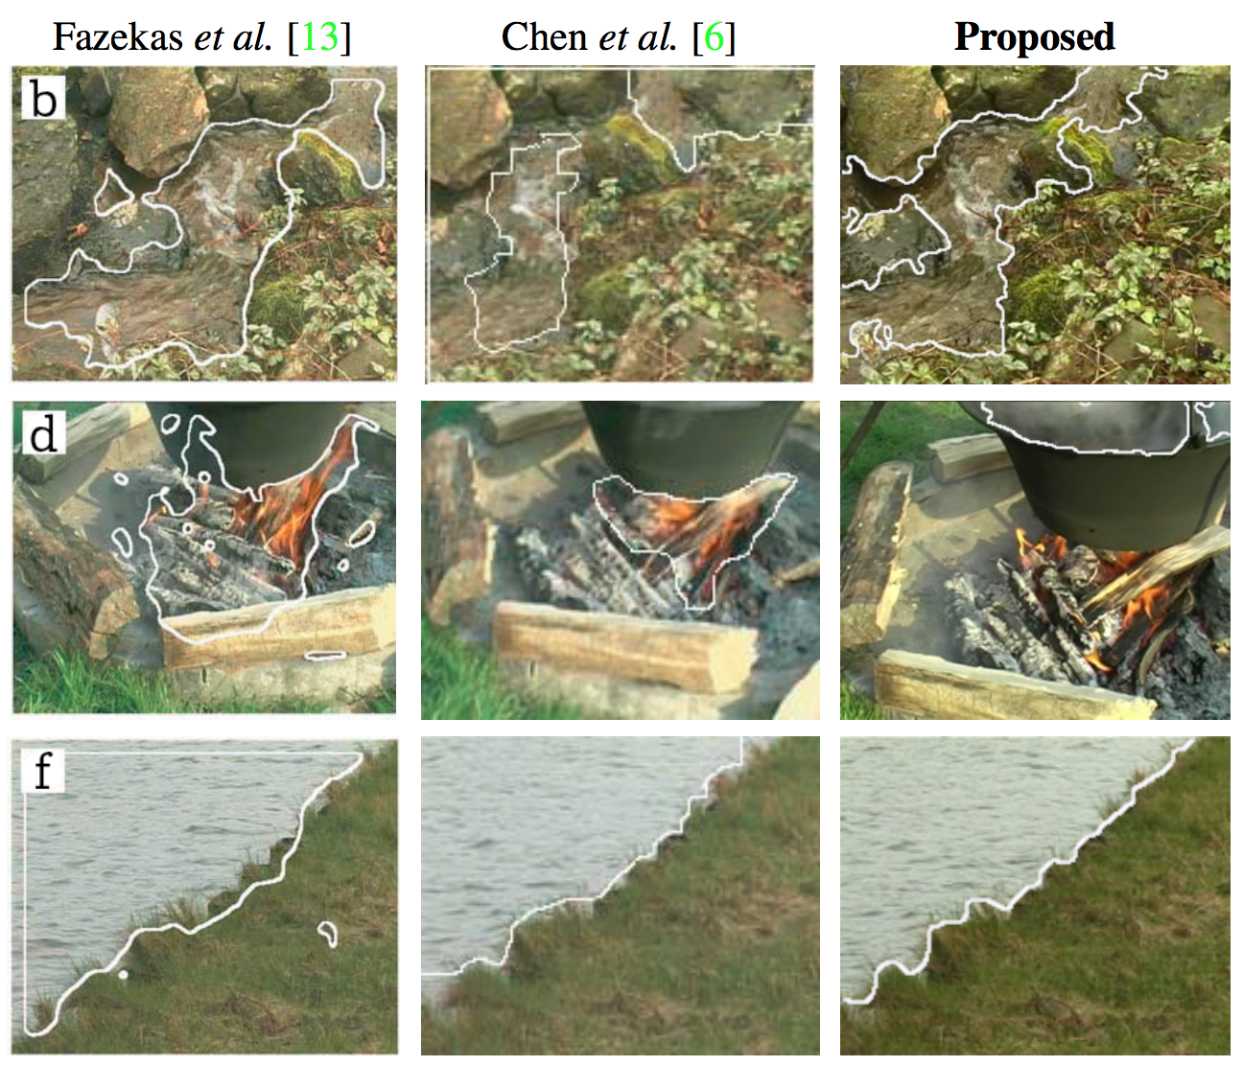
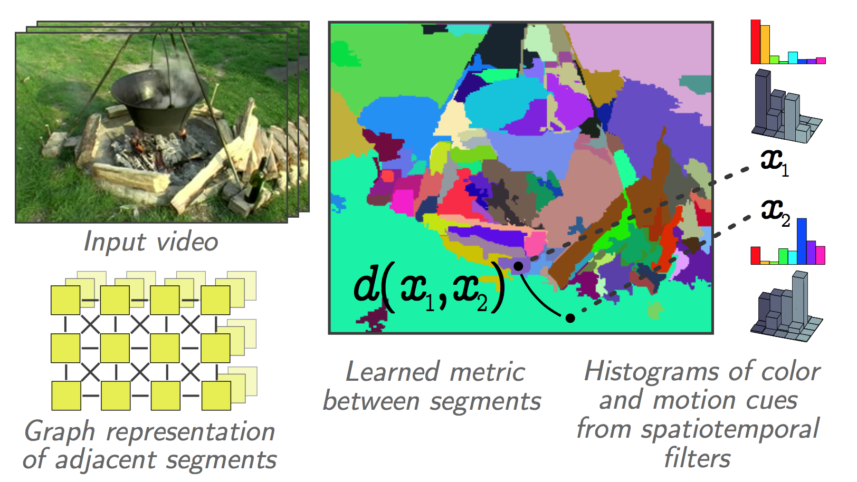
Other Applications
Video scene segmentation
Identifying dynamic textures in videos

Slide 29
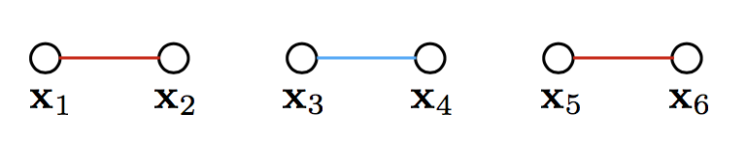
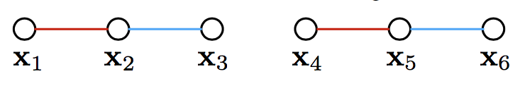
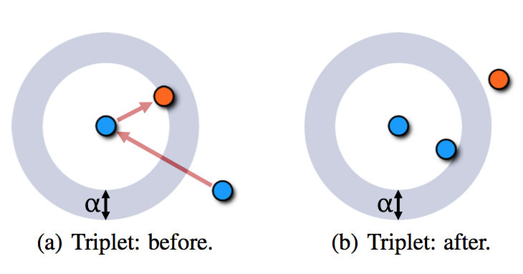
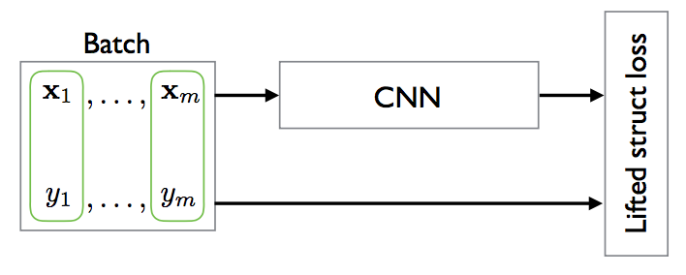
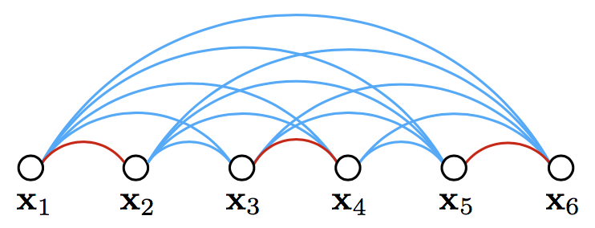
Other Formulations
Deep metric learning
Differentiates different metric constraints
Contrastive
Triplet
Lifted structure

Slide 30
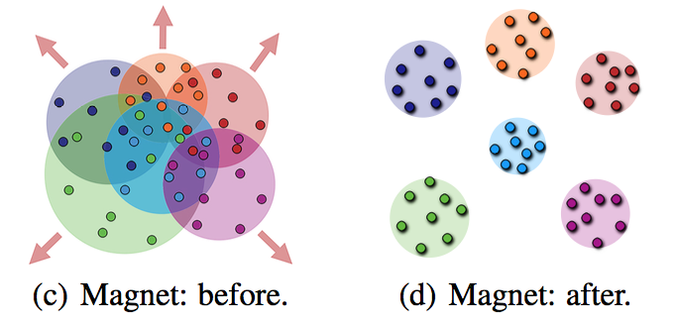
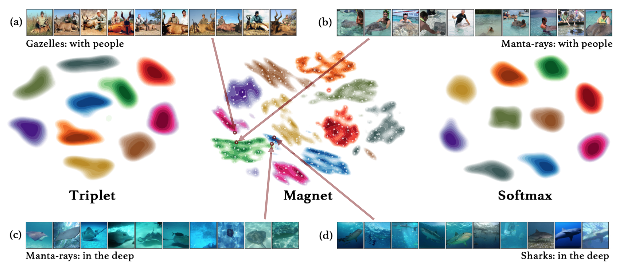
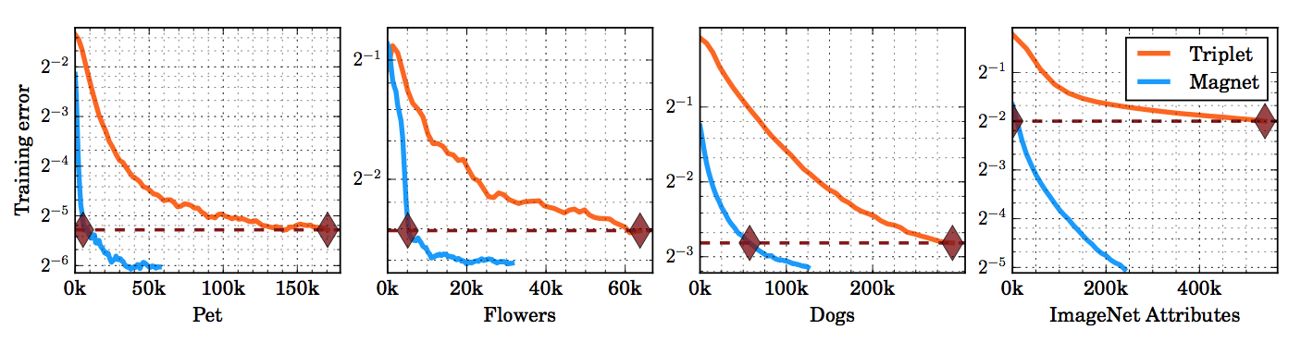
Other Formulations
Adaptive densities
Introduces “magnet loss” (how does it work?)
Optimizes over entire neighborhoods simultaneously
Reduces distribution overlap, rather than just pairs or triplets
Requires ground-truth labels

Slide 31
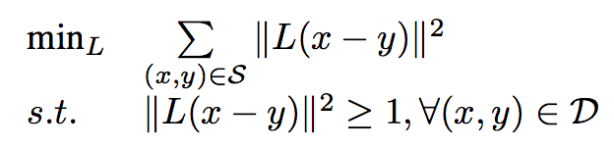
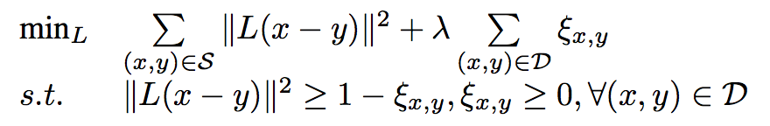
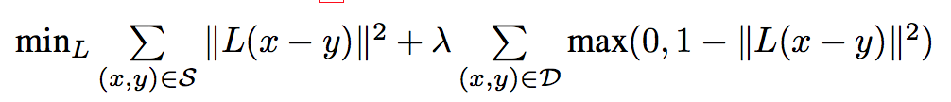
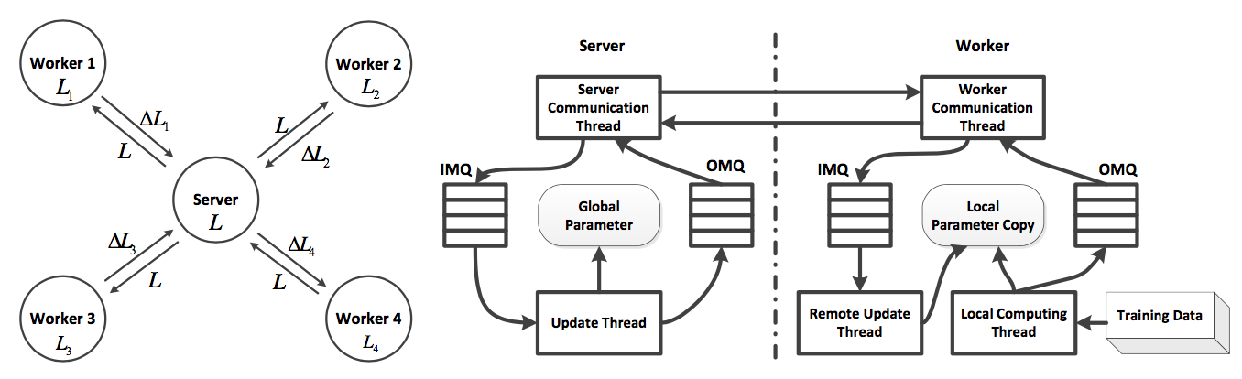
Other Formulations
Large-scale metric learning
If feature space is extremely large, iterative eigen-decompositions are a deal-breaker
Nested convex optimization is a deal-breaker
Represent metric A = L^{T}L
Learn L directly, instead of A
Use hinge loss to induce unconstrained optimization
Parameter server for SGD-based metric updates

Slide 32
Questions?

Slide 34
Midterm Exam
Some true/false
Some short answer
Some multi-part problems (like the homeworks)
Some “coding” (very short)
Thursday, Oct 12 (normal lecture time, normal lecture location)

Slide 35
Final Projects
Teams! (2-4 people)
~1.5 homeworks in scope/size
Some kind of data science + machine learning problem
Deliverables (proposal, update #1, update #2, final presentations)
Proposals: due Tuesday, Oct 17 by 11:59pm
1-page (maximum) with i) what problem you’re working on, ii) how you intend to solve it, iii) what your validation plan is (how do you know it worked or didn’t work?).
Only 1 submission needed per team, should include names of your teammates

Slide 36

IOB Symposium
https://iob.uga.edu/symposium2023/ (posted in #lounge)
Oct 16-17
No class on Monday, Oct 16 or Tuesday, Oct 17
Class as usual on Thursday, Oct 19
A workshop!

Slide 37
References
Xing, Eric P., Michael I. Jordan, Stuart J. Russell, and Andrew Y. Ng. “Distance metric learning with application to clustering with side-information” http://papers.nips.cc/paper/2164-distance-metric-learning-with-application-to-clustering-with-side-information.pdf
Teney, Damien, Matthew Brown, Dmitry Kit, and Peter Hall. “Learning similarity metrics for dynamic scene segmentation” http://www.cv-foundation.org/openaccess/content_cvpr_2015/papers/Teney_Learning_Similarity_Metrics_2015_CVPR_paper.pdf
Oh Song, Hyun, Yu Xiang, Stefanie Jegelka, and Silvio Savarese. “Deep metric learning via lifted structured feature embedding” http://www.cv-foundation.org/openaccess/content_cvpr_2016/papers/Song_Deep_Metric_Learning_CVPR_2016_paper.pdf

